Slide 1

7th Grade Math
Unit 6, Lesson 6 Creating Proportions Volume 1, pg. 262

Slide 2


Benchmark
MA.7.AR.3.2
Apply previous understanding of ratios to solve real-world problems involving proportions.
volume 1, pg. 262

Slide 3
Integrated Mathematical Thinking and Reasoning Standards
MA.K12.MTR.2.1 Demonstrate understanding by representing problems in multiple ways.
volume 1, pg. 262

Slide 4

Learning Target
I can create proportions to represent a situation.
volume 1, pg. 262

Slide 5

Warm-Up
volume 1, pg. 263

Slide 6
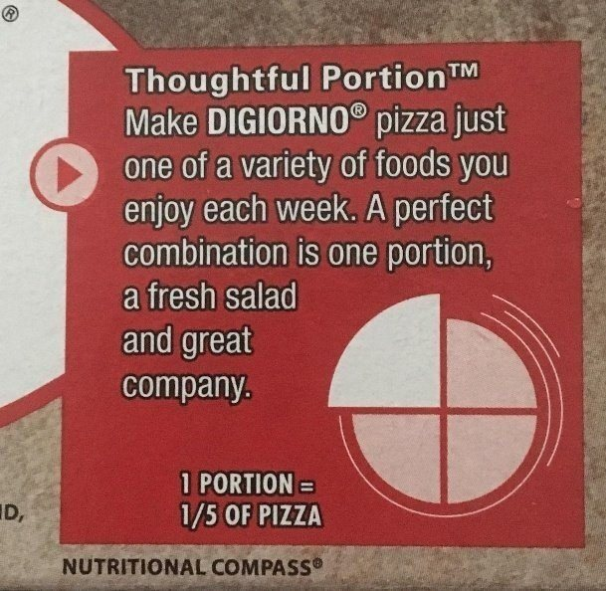
6.6.1 Warm-Up: Math Flop
The advertisement encourages making DiGiorno pizza a part of your weekly meals.
What do you notice about the advertisement?
volume 1, pg. 263

Slide 7


Exploration
volume 1, pg. 263

Slide 8

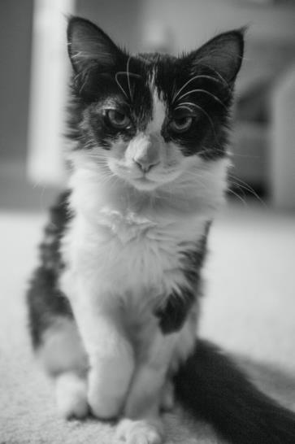




6.6.2 Exploration: Proportional Thinking
A photograph is enlarged to make a poster. Measurements are given in centimeters (cm).
$16$cm
?
$10$ cm
$25$ cm
volume 1, pg. 263

Slide 9
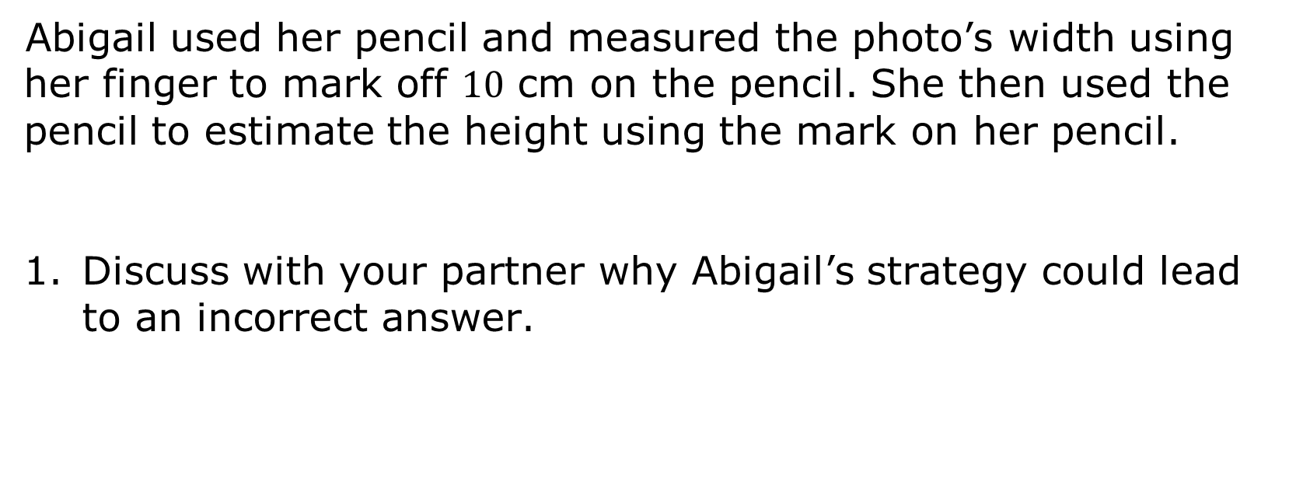
Abigail used her pencil and measured the photo’s width using her finger to mark off $10$ cm on the pencil. She then used the pencil to estimate the height using the mark on her pencil.
Discuss with your partner why Abigail’s strategy could lead to an incorrect answer.
volume 1, pg. 263

Slide 10
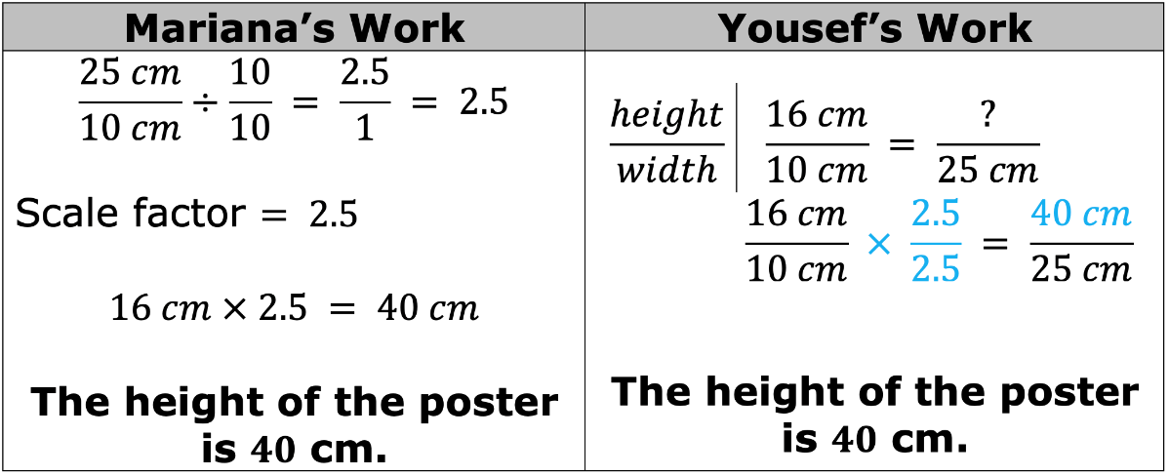
Mariana and Yousef used different strategies to find the height of the poster. Review their solution strategies. Then, work with your partner to answer the questions that follow.
volume 1, pg. 264

Slide 11
How are Mariana and Yousef’s solution strategies similar?
How are their solution strategies different?
volume 1, pg. 264

Slide 12

Bring It Together
volume 1, pg. 264

Slide 13




6.6.3 Bring It Together: Proportional Relationships
In a proportional relationship, the values for one quantity are each multiplied by the same number to get the values for the other quantity.
A proportion sets two or more equivalent ratios in such relationships as equal to each other and can be used to solve problems.
A unit rate is a ratio comparing a number of units of one quantity to $1$ unit of a second quantity.
volume 1, pg. 264

Slide 14
Use the words and phrases in the bank below to complete the description of Mariana and Yousef’s work.
is equal to proportion ratio unit rate
The photograph and the poster are in a proportional relationship because the poster is a scaled version of the photograph. Mariana found the scale factor, which is a _______________, and multiplied it by the height of the photo to find the height of the poster. Yousef set up a _______________ stating the _______________ of the height to width of the photograph _______________ the ratio of the height to width of the poster.
volume 1, pg. 264

Slide 15

Guided Instruction
volume 1, pg. 265

Slide 16

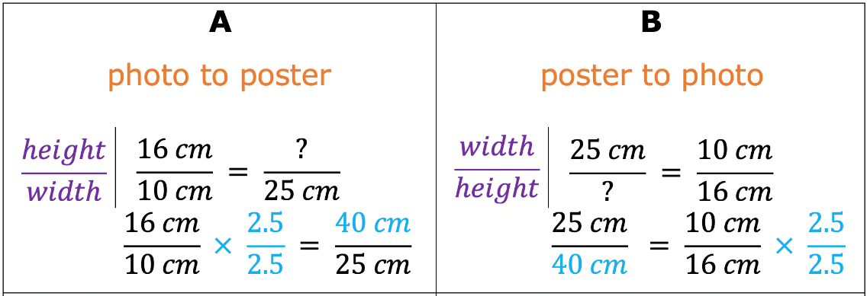
6.6.4 Guided Instruction: Proportional Thinking
Proportions can be set up in different ways using the relationships between each quantity.
Four different proportions that can be used to find the height of the poster are shown.
volume 1, pg. 265

Slide 17
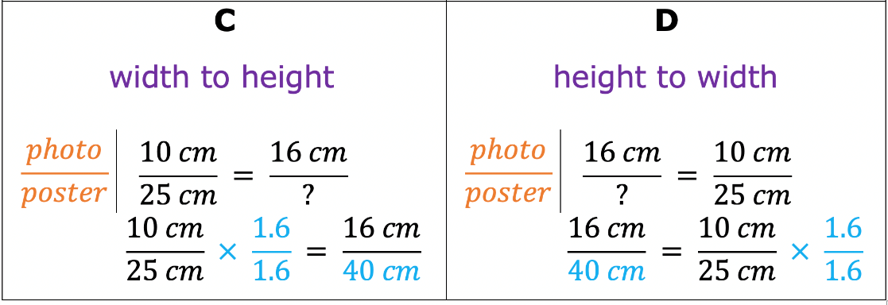
All of the proportions show that the ratios of the dimensions of the photograph and the dimensions of the poster are equivalent.
volume 1, pg. 265

Slide 18
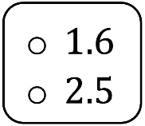
Complete the statements based on the proportions.
The dimensions of the poster are times larger than the photograph.
The height of both the photograph and poster is times larger than the width.
volume 1, pg. 265

Slide 19

Guided Practice
volume 1, pg. 265

Slide 20

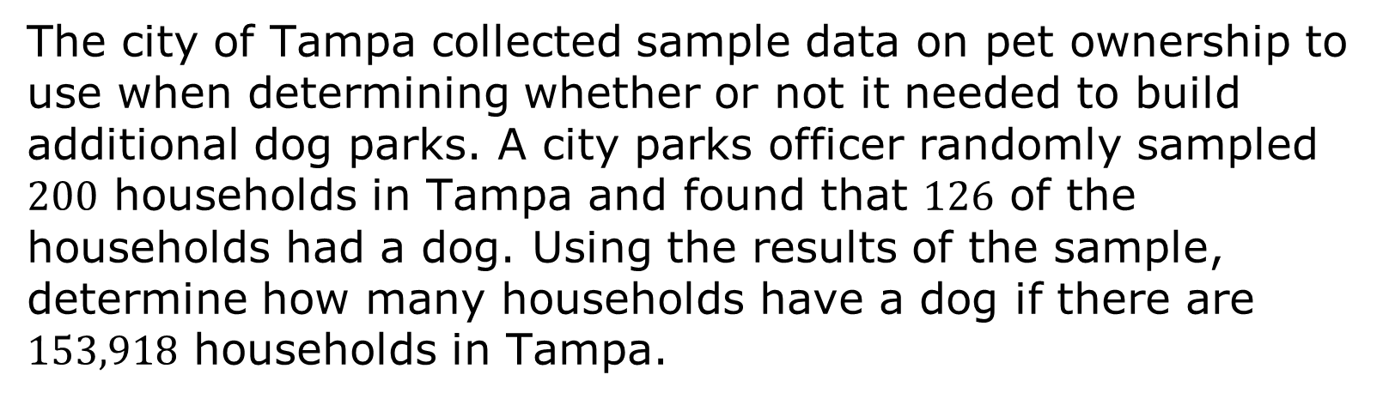
6.6.5 Guided Practice: Proportional Thinking
The city of Tampa collected sample data on pet ownership to use when determining whether or not it needed to build additional dog parks. A city parks officer randomly sampled $200$ households in Tampa and found that $126$ of the households had a dog. Using the results of the sample, determine how many households have a dog if there are
$153,918$ households in Tampa.
volume 1, pg. 265

Slide 21
Complete the statements to describe the relationships that are being compared.
The number of households with a dog is being
compared to the ______________________.
The data sample is being compared to the
___________________________ of Tampa.
volume 1, pg. 265

Slide 22
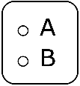
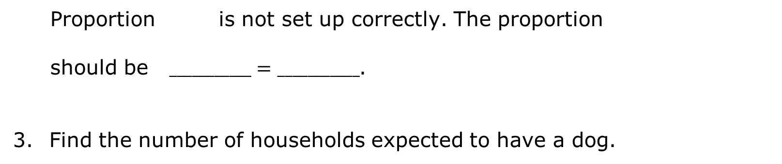
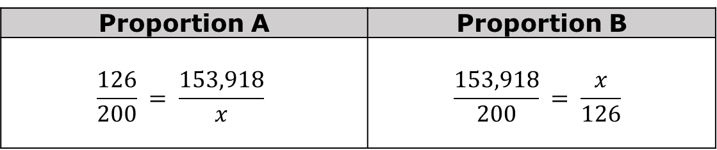
Two proportions that represent this situation are below, but one of them has an error.
Proportion A | Proportion B
$$\frac{126}{200} = \frac{153,918}{x}$$ | $$\frac{153,918}{200} = \frac{x}{126}$$
Proportion is not set up correctly. The proportion
should be $___________=___________$.
Find the number of households expected to have a dog.
volume 1, pg. 265

Slide 23

Collaboration
volume 1, pg. 266

Slide 24

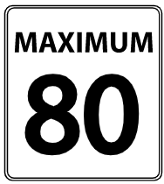
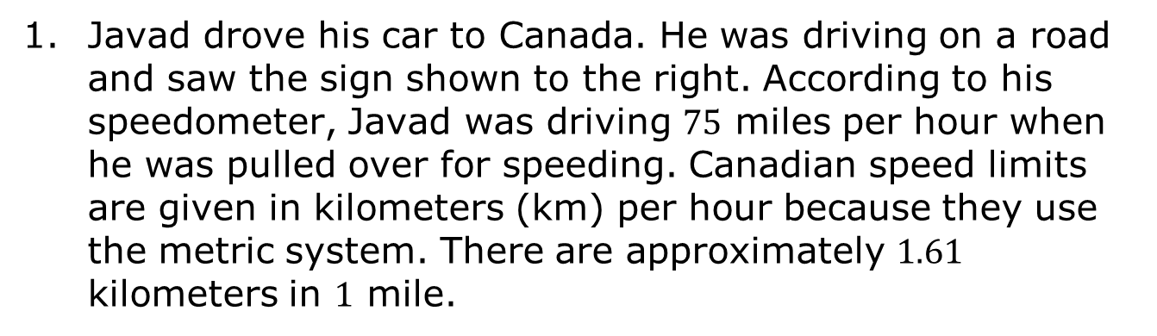
6.6.6 Collaboration: Creating Proportions
Javad drove his car to Canada. He was driving on a road and saw the sign shown to the right. According to his speedometer, Javad was driving $75$ miles per hour when he was pulled over for speeding. Canadian speed limits are given in kilometers (km) per hour because they use the metric system. There are approximately $1.61$ kilometers in $1$ mile.
volume 1, pg. 266

Slide 25
Create two different proportions that could be used to find Javad’s speed in kilometers per hour.
Proportion A | Proportion B
How fast was Javad traveling in kilometers per hour?
volume 1, pg. 266

Slide 26

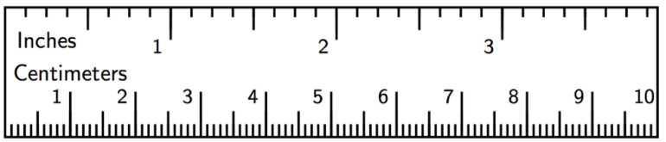
An architect made a scale drawing of a house as shown.
The scale for the drawing is $\frac{1}{4}$ inch = $6$ feet.
volume 1, pg. 266

Slide 27
Create two different proportions that could be used to find the actual length of the house represented by the drawing.
Proportion A | Proportion B
What is the length of the house represented by the drawing?
volume 1, pg. 266

Slide 28

Wrap-Up
volume 1, pg. 267

Slide 29
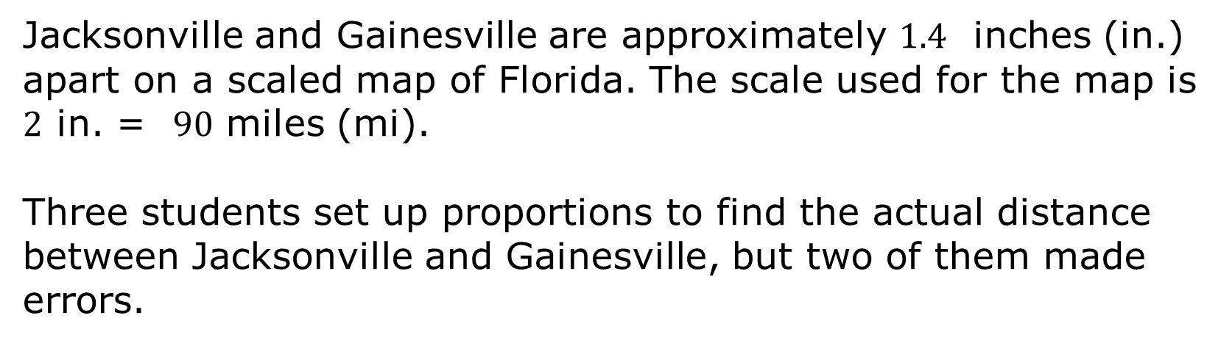
6.6.7 Wrap-Up: Error Analysis
Jacksonville and Gainesville are approximately $1.4$ inches (in.) apart on a scaled map of Florida. The scale used for the map is $2$ in. = $90$ miles (mi).
Three students set up proportions to find the actual distance between Jacksonville and Gainesville, but two of them made errors.
volume 1, pg. 267

Slide 30
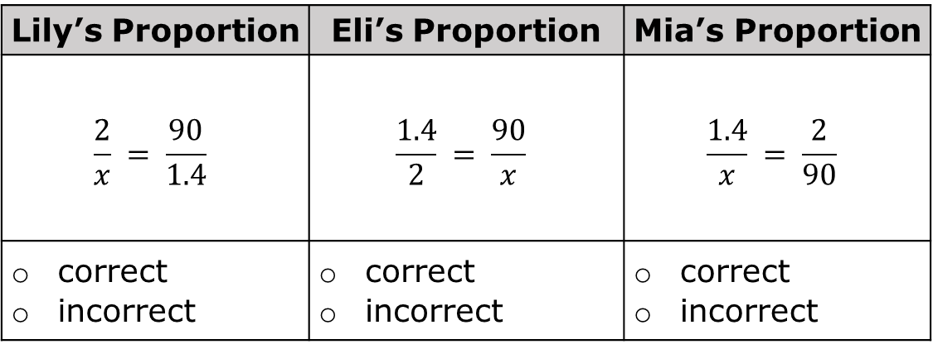
For each proportion, check whether it is correct or incorrect. If it is incorrect, fix the error by changing one of the ratios in the proportion.
Lily’s Proportion | Eli’s Proportion | Mia’s Proportion
$$\frac{2}{x} = \frac{90}{1.4}$$ | $$\frac{1.4}{2} = \frac{90}{x}$$ | $$\frac{1.4}{x} = \frac{2}{90}$$
correct incorrect | correct incorrect | correct incorrect
volume 1, pg. 267

